Slide 1
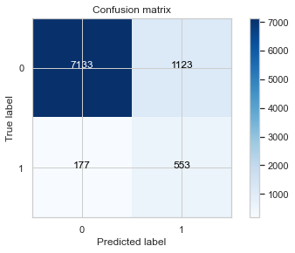

Model Accuracy

Slide 2
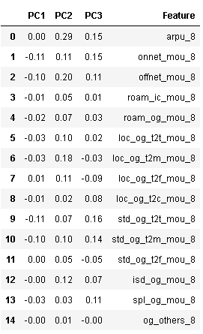
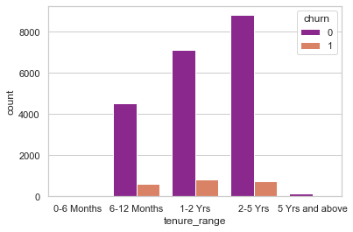
Important Features

Slide 3
Point Based on Analysis
Last 6 months no new high value customers
Customers less than 4 years should be taken care of as they would possibly churn
Average revenue per user – Most important Feature
Incoming and Outgoing during roaming is possible reason as well
Local calls to different modes is very strong reason for churn
Better 2G/3G area coverage where 2G/3G services are not good, is also important for churn

